Slide 1

Shifting threat intelligence
Through the lens of APT29

Slide 2
Topics covered
The problems with threat intelligence and a different way forward
01
Gather and analyse open source threat intelligence on APT29
02
Turn threat intelligence into a prioritised control list
03

Slide 3

The bias of this presentation
I am only talking about sophisticated adversaries
I am mostly looking at Windows based environments
This talk uses the term ‘threat intelligence’ to mean any information about adversaries that could be used to improve the security posture of an organisation
Notes:
Sophisticated adversaries
Windows
Any info about adversaries could use to improve security posture

Slide 4

01 The problems with threat intelligence and a different way forward

Slide 5
APTs - What we are actually defending against
Policy makers
Intelligence organisation
Management, coordination, targeting
C&C
Infra
Tools
Analysis
Translators
Sysadmin
Hackers
Notes:
Talk about boxes
This is a well practiced machine

Slide 6

We can put a wrench in all that with threat intelligence… right?
The idea is we can slow adversaries by halting their operations through detecting things like malware, suspicious connections, and malicious files.
The APT has to spend time and money in developing new malware to get their operations going again.
Notes:
Halt through detection
Time and money re-developing

Slide 7
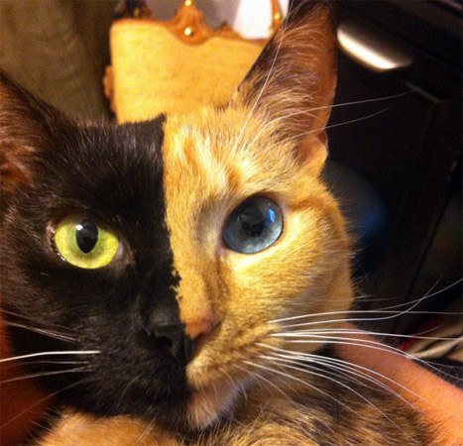
Tactical and strategic threat intelligence
Tactical threat intelligence – Indicators of compromise, IoCs
Strategic threat intelligence – Tactics, Techniques and Procedures, TTPs

Slide 8

The reality
Few organisations are mature enough to consume tactical threat intelligence effectively. Do you have a monitoring program? Are you ingesting everything? When was the last time you audited that?
What we think of as threat intelligence is mostly just marketing
The idea that sharing IoCs will result halting APT operations and force them to retool is simplistic
Notes:
Mature consume tactical
Marketing
Sharing iocs halting APTS simplistic

Slide 9
SIPA Capstone Project Spring 2020
Named but Hardly Shamed, The Impact of Information Disclosure on APT Operations
U.S. focused
What is the impact of leaks and information disclosures on adversary operations?
How can the answer to the first question inform the U.S. strategy of persistent engagement and forward defence?
Under what conditions is a disruption likely to succeed?
Paper breaks down the cyber operations of a number of countries over the last ten years and sees if information being released into the public domain actually degraded their capabilities.
Notes:
Named but Hardly Shamed, The Impact of Information Disclosure on APT Operations
US
Impact of leaks and info disclosure on adv ops
Persistent engagement
When does disruption succeed
Breaks down ops of other countries over ten years did disclosure degrade

Slide 10
Findings
Public disclosures generally failed to stop APT operations or cause long term disruption, but that they do often impose at least short term friction.
Disruptive effect varies significantly based on a number of factors, including the scope of the disclosure and the disclosing actor. However, disclosures may in fact also lead to APTs becoming more resilient and creative because they need to retool, rebuild their infrastructure, or change their TTPs. The exception to this is APT1 and APT10, both who ceased operations following highly public disclosures and U.S. Department of Justice indictments.
Disclosures are somewhat useful in achieving the U.S. objectives of persistent engagement by imposing costs and increasing the resiliency of networks. However, the level of costs imposed by disclosure events is simply not high enough to significantly change the decision calculus of most adversaries conducting cyber activity. Disclosures must be carefully targeted and used in combination with other elements of power.
Private cybersecurity vendors hoping to use information disclosure offensively should consider the geostrategic context in which they operate, and they should target disclosures more effectively to counter individual groups.
Notes:
Disclosures failed to stop APT ops did impose short term friction
Disruptive effects vary, scope, disclosing actor.
May lead to more resilience, retool, change TTPs
Exception APT1 and APT10
Costs imposed by disclosures not high enough to change decision calculus
Targeted and combined with other elements of power

Slide 11
And then there is APT29…
AKA Cozy Bear, TheDukes
Researchers have been taken aback by the insidiousness and quality of its TTPs and platforms, and its ability to develop advanced, bespoke toolsets in rapid succession. This trend characteristic has been evident since OnionDuke, which quickly superseded CozyDuke and MiniDuke after Kaspersky reported on them in July 2014. Two potential conclusions arise. APT29 could consist of an ingenious team of hackers whose software development capacity renders disruption nearly impossible, what one may expect from a military cyber unit or from a sophisticated criminal organisation. At the same time, the group may prepossess an arsenal of toolsets, increasing in sophistication, that await deployment. Both possibilities, or a combination of the two, concede that highly capable adversaries are less vulnerable to disruption from disclosure events.
Language a little overblown but what they are saying is this group is operationally sophisticated.

Slide 12

Additional thoughts
Many vendors are just in it for the money so would not be interested in coordination
The report only looks at the detriment on APTs, not the benefit to industry.
Adversaries will always try and collect or perform active measures. Is ‘we can’t stop them’ a useful conclusion?
Not all the information available to the Capstone report is in the public domain so the findings cannot be reproduced
Let’s perform some research
Notes:
Vendors money
Detriment APTs benefit industry
We can’t stop them useful
Closed source

Slide 13
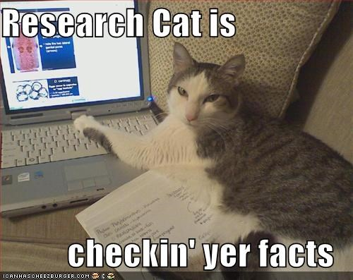
02 Gather and analyse open source threat intelligence on APT29

Slide 14

Timeline of APT29
2008 November – First known compile date of SeaDuke and PinchDuke
2009 January – First known compile date of GeminiDuke – creating malware despite a lack of publicity
2009 April – targets government entities and foreign policy thinktanks
2009 April – targets political organisations
2010 – First known compile date of MiniDuke – still creating malware despite a lack of publicity
2010 – First known compile of CosmicDuke
2010 Northern Hemisphere Spring – targets a number of government entities, last known compile date of PinchDuke – dropped malware despite a lack of publicity
2011 – CozyDuke developed, stylistically different from previous malware – improving malware despite a lack of publicity
Notes:
2008 First known compile date SeaDuke and PinchDuke
Other malware and targeting government
Malware refined

Slide 15
2012 – Nothing…
2013 – Targets a number of government entities
2013 February – Earliest compile date of OnionDuke. Three articles are published covering different aspects of MiniDuke – first time APT29 is discovered
2013 Northern Hemisphere Summer – OnionDuke being spread by Torrent files
2013 September – Earliest compile date of PolygotDuke, separately campaign starts targeting individuals selling growth hormones within the country APT29 is believed to operate from – a pivot from espionage to law enforcement
2013 October – A malicious TOR exit node starts serving up OnionDuke
2014 – An intelligence agency compromises computers and security cameras in a building APT29 worked out of
2014 Northern Hemisphere Spring – OnionDuke compromises a government entity, not through the TOR exit node, APT29 pivots away from law enforcement and back to pure espionage
Notes:
2013, still targeting governments, still building new malware
2013 September new campaign targeting hormones their own country
2014 intel agency compromises building
Had come to attention of intel agencies but not public
Pivot back to pure espionage – just under a year

Slide 16
2014 July –Two reports covering CosmicDuke are published and claims it’s used to target government entities, energy and telco operators, military organisations and military contractors – scope has widened. By the end of the month Cosmic Duke is stripped back but still being deployed
2014 October – First and last compile of LiteDuke. The White House unclassified network is hacked. An article on OnionDuke is published
2014 November – Another paper on OnionDuke published. OnionDuke isn’t seen again – potentially due to being exposed. The US State Department shuts down email system trying to evict APT29
2015 January – high volume spearphishing campaign, initial infection with CozyDuke, interesting targets get SeaDuke and HammerDuke
2015 March – two articles released covering an attack on a government entity
2015 July – targets think tanks and NGOs through spearphishing with new CloudDuke. Two articles are published on CloudDuke. Same month APT29 send another wave of emails still with CloudDuke – they did not care it was exposed
Notes:
2014 July two reports on CosmicDuke
First time in public
Hidden for at least 6 years
CosmicDuke refined but still used
OnionDuke exposed and not seen again
2015 January spearphishing with CozyDuke
2015 July spearphishing with CloudDuke. Two articles published, same months another wave with CloudDuke

Slide 17
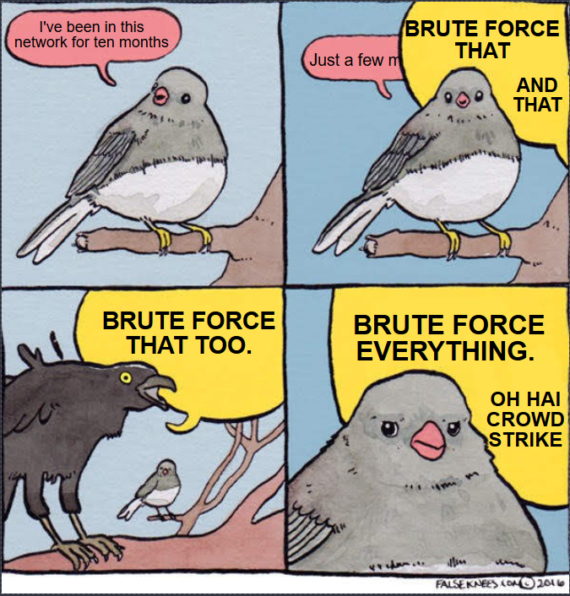
2015 July – enters the network of the Democratic National Committee using SeaDuke
2016 April – APT28 also enter the DNC network and proceed to be very noisy
2016 May – Crowstrike are on-site performing incident response for the DNC and SeaDuke is never seen again
2016 June – DNC breach announced
Notes:
2015 July enter the DNC
There for ten months
2016 April APT28
Next month Crowdstrike
Next month public announcement

Slide 18
2016 August – The show must go on. Spearphishing wave against think tanks and NGOs using PowerDuke
2016 September – First compile date of Fatduke
2016 November – More spearphishing with PowerDuke
2017 – Multiple attacks on government entities but otherwise pretty quiet
2017 August – First compile date of RegDuke
2018 August – Last sighting of RegDuke
2018 October – Article published covering RegDuke, PolygotDuke and FatDuke, they aren’t seen again, but at least RegDuke had not been seen for two months already
2019 October – article published covering a years long campaign, running from before 2015, targeting government entities
Notes:
2016 August show must go on spearphishing PowerDuke
Rest of 2016 into 2017 making new malware
2018 October an article covers RegDuke, PolyglotDuke and FatDuke, already stopped deploying
2019 still going

Slide 19

So that wrench kinda doesn’t work…
Different malware is developed in parallel, not created out a need to replace burned malware
Malware can be retired of APT29’s own accord, not in response to being burned
Sometimes revealing a tool makes APT29 retire it, sometimes they don’t care
Some of their malware, like MiniDuke and CosmicDuke, was in use for years, and covered multiple times. APT29 just refined and carried on
Despite severe attention after 2016 they carried on
Multiple reports published covered long spanning campaigns that no one previously covered until that point, a result of APT29’s stealth. We only have part of the whole picture.
Notes:
Malware parallel not replacing out of need as burned
Retired of own accord, not burned
Sometimes revealing makes retire, sometimes not
One in use for years and covered multiple
Multiple reports long spanning campaigns

Slide 20

If releasing papers and IoCs doesn’t stop our adversary, what do we do?
Rather than thinking about burning an APT, think about protecting yourself
Rather than detecting IoCs, think about mitigating TTPs
TTPs map to mitigations and detections
This is not a new idea but not widely adopted https://www.youtube.com/watch?v=bkfwMADar0M
Notes:
Burning APTs protect yourself
IoCs – TTPs
Map to mitigations and detections
Not new

Slide 21

Generating actionable strategic threat intelligence
Work through info stored in Panopticon Project https://github.com/Panopticon-Project
Map reports to Mitre Att&ck
Where things are unclear, such as how exploits work, perform research
Where tools are mentioned map all the capabilities of the tools
Work out what to include and exclude, Pre Att&ck and Enterprise
Create an excel sheet broken down by year
Add TTPs to Excel taking into account timeframe
Visualise that
I got through roughly a third of what I have
Notes:
Info panopticon project
Map Mitre
Unclear research
Tools
Pre-attack, enterprise
Excel by year
Visualise
1/3rd

Slide 22
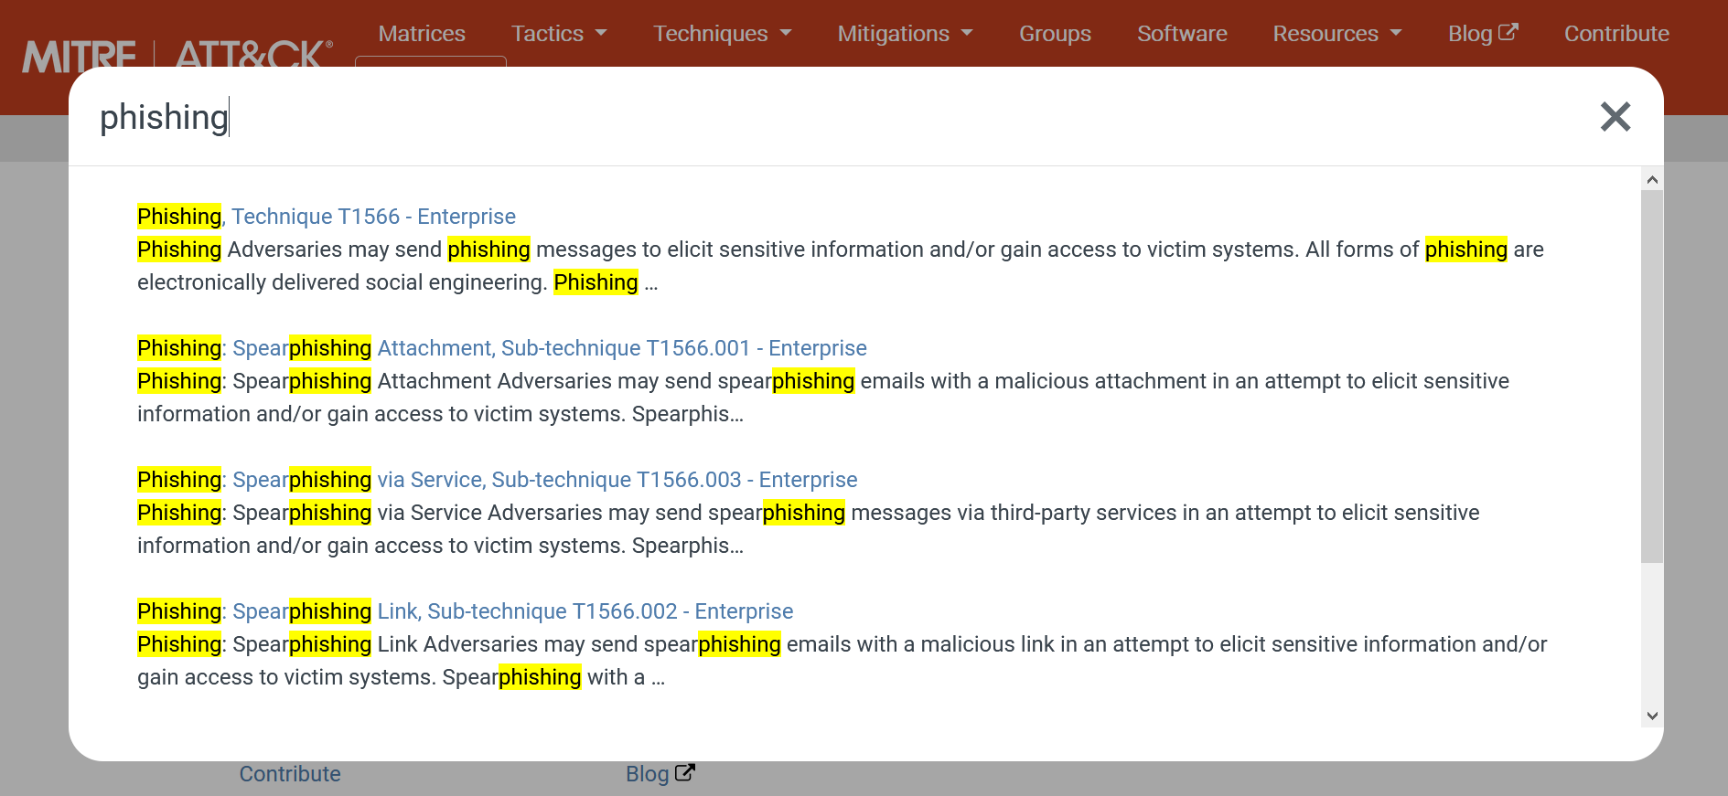
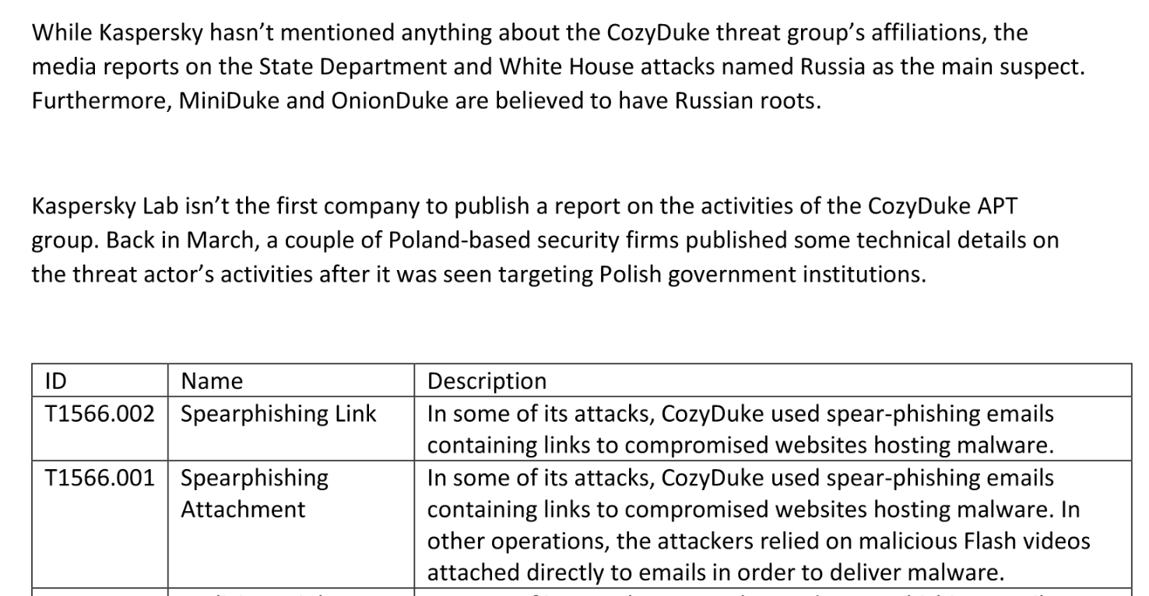
Mapping to Mitre Att&ack isn’t black magic
Just highlight anything that sounds like a TTP and then pick which TTP fits best
Search the framework, Ctrl-F, or Search Engine if you get stuck

Slide 23
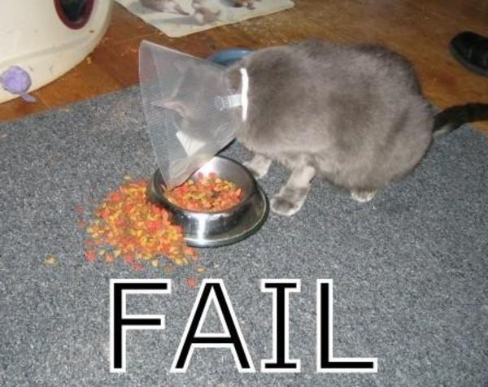
Shortcomings of my research
I am relying on others for attribution. For example some say APT29 doesn’t exist anymore, some say it’s still going.
I am the only one that coded the reports using Mitre Att&ck, my biases will be present
I tried to use TRAM, doesn’t work out of the box, debugging it was longer than manually coding the reports
Reports are not consistent and sometimes vague. “The malware uses encryption” can mean many things
A report can say broadly across many years TTPs were observed. Doesn’t give a clear indication if a TTP was present every single time
Reports can have no time reference
Compile times are used as time references but those aren’t completely reliable
The use of malware names can be shorthand for a set of functionality, doesn’t take into account that malware is developed over time
Some of the sources aren’t primary as I’m relying on English language reporting of things reported overseas, plus working to talk timeframes
If there is less reporting on APTs it could look like a lack of activity
Notes:
Attribution
Only mapper
TRAM
Malware uses encryption
Time
Compile
Malware names shorthand functionality
Primary translations
Less reporting appears less active

Slide 24

Strengths of my research
You start to see the connections over time
The dataset is greater than the sum of its parts. One piece might talk about malware seen recently and you mark those TTPs as just recent. But then another piece references that malware from years ago so you can say that the APT displayed those TTPS over the intervening years, which each report in isolation couldn’t have given you
A report might not talk about something like Valid Accounts being used for access, but might mention that they are set up once the attacker is in the environment. By mapping TTP Valid Accounts in all the places it is present in Mitre Att&ck we see what the APT is capable of
Multiple points of corroboration for TTPs, mitigates biases somewhat
You see the broad strokes of biases in our industry
Notes:
Connections
Dataset greater than sum of parts
Valid accounts used for access
Multiple points of corroboration
Biases in industry

Slide 25

03 Turn threat intelligence into a prioritised control list

Slide 26
Initial Access
Mostly phishing, sharp decline in detected attacks post 2016
Drive-by Compromise is things like OnionDuke
Valid accounts can be set up post “first” exploit and allow access later
Notes:
Phishing this is what we are talking about
Valid accounts later

Slide 27
Phishing Mitigations
Antivirus and Network Intrusion Prevention – Email scanning
User Training
Notes:
AV Network Intrusion Prevention
Email scanning
User training

Slide 28
Execution
Command and Scripting Interpreter and WMI through malware
Humans doing a lot of work with user execution
Again, dip post 2016 but then came back briefly
WMI always present
Notes:
Command and Scripting Interpreter
Humans doing a lot of the work

Slide 29
Command and Scripting Interpreter Mitigations
Antivirus
Disable or Remove Feature or Program - Hardening
Execution Prevention
Notes:
AV
Hardening
Execution Prevention

Slide 30
Persistence
Cut the TTPs with no hits
Mixed bag but consistently Event Triggered Execution and Valid Accounts used
Numbers are all less than 3 instances
Notes:
Event triggered execution
Low numbers
8s and 7s tops now 3

Slide 31
Event Triggered Execution Mitigations
Not many so let’s go with Detection
Monitor for additions or modifications of mechanisms that could be used to trigger event-based execution
Notes:
Detection
Monitor for modification to mechanisms used to trigger

Slide 32
Privilege Escalation
Event Triggered Execution and Valid Accounts used
Process Injection fairly consistent
Spike in Access Token Manipulation
Numbers are all less than 3 instances
Notes:
Event triggered Execution
Low numbers
Spike access token manipulation probably not a spike

Slide 33
Event Triggered Execution Mitigations
Not many so let’s go with Detection
Monitor for additions or modifications of mechanisms that could be used to trigger event-based execution
Notes:
Again

Slide 34
Defense Evasion
Cut the TTPs with no hits
No Execution Guardrails…
Many seen every year or all bar one year
Obfuscated Files or Information dropped off but in line with overall detection
Notes:
No Execution Guardrails
Obfuscated files or information

Slide 35

APT29 often uses sub techniques like binary padding, software packing and indicator removal from tools
Notes:
Can break this down further
Binary padding
Software packing
Indicator removal

Slide 36
Obfuscated Files or Information Mitigations
Antivirus
Also for Detection - Network Intrusion Prevention
Notes:
AV
Network Intrusion Prevention

Slide 37
Credential Access
Cut the TTPs with no hits
Low numbers
Some years nothing was reported
Ongoing trend
Extrapolating this there are a small number of ways to gather credentials used consistently
Notes:
Low numbers
Some years nothing reported
Ongoing trend
Small number of ways consistent get credentials

Slide 38
OS Credential Dumping Mitigations
Active Directory Configurations – lock down domain controller replication, use Protected Users AD security group
DC backups encrypted
Strong Password Policies
Privileged Account Management
Monitor processes interacting with lsass.exe- LSA Subsystem Service (LSASS)
Notes:
AD configurations lock down domain controller replication
Protected users AD security group
DC backups encrypted
Password policies
Privileged account management
Monitor interaction lsass.exe

Slide 39
Discovery
Cut the TTPs with no hits
Low numbers
Some years nothing was reported
Ongoing trend
Extrapolating this there are a small number of ways to discover information about the environment used consistently
Notes:
Low numbers
Some years nothing
Ongoing trend
Small number of ways

Slide 40
System Information Discovery Mitigations
Not many so lets look at Detection
Monitor processes and command-line arguments for actions that gather system and network information
Monitor for interaction with the Windows API to gather information
Monitor for interaction with Windows system management tools - Windows Management Instrumentation and PowerShell
Notes:
System information discovery
Detection
Monitor processes and command line actions gather info
Interaction with windows API gather info
Interaction Windows System Management Instrumentation + PowerShell

Slide 41
Lateral Movement
Low numbers
Some years nothing was reported
Ongoing trend
Use Alternate Authentication Material often Pass the Hash/Pass the Ticket from Mimikatz
Notes:
Very low numbers
Some years nothing
ongoing

Slide 42
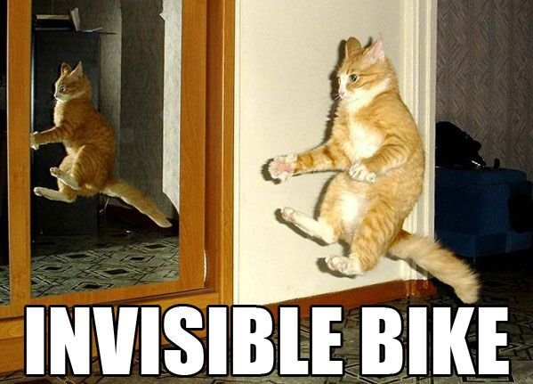
Lateral movement is still going on. Clearly something is happening we can’t see.
Notes:
Lateral movement still happening

Slide 43
Remote Services Mitigations
Multi-factor Authentication for Remote Services
User Account Management – restrict access to Remote Services
Notes:
MFA remote services
Restrict access to remote services

Slide 44
Collection
Cut the TTPs with no hits
Low numbers
Some years nothing was reported
Ongoing trend
Extrapolating this there are a small number of ways to collect information used consistently
Notes:
Low numbers
Small way collection

Slide 45
Archive Collected Data Mitigations
Not many so let’s go with Detection
Detect the writing of files with extensions and/or headers associated with compressed or encrypted file types
Correlate with exfiltration – SIEM solution
Notes:
Archive Collection Data Mitigation
Detection
Detect writing extensions associated with compressed/encrypted file types
Correlate with exfil - SIEM

Slide 46
Command and Control
Cut the TTPs with no hits
HTTP consistent Application Layer Protocol
Steganography consistent Data Obfuscation
A lot of communication encrypted
Twitter and Dropbox consistently used as C&C
Notes:
Data obfuscation
Steganography consistent
Twitter and dropbox c&c

Slide 47
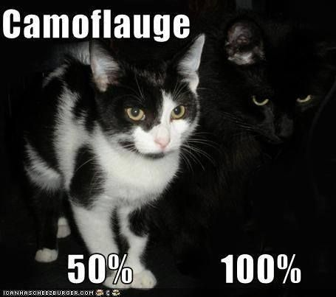
APT29 would often use steganography for their C&C. They do not want to be found!

Slide 48
Data Obfuscation Mitigations
Network Intrusion Prevention
Notes:
Network Intrusion Prevention

Slide 49
Exfiltration
Low numbers
Some years nothing was reported
Ongoing trend
Exfiltration Over C2 Channel is consistent
Notes:
Low numbers
Some years nothing
Exfil over c2 consistent

Slide 50
Exfiltration over C2 Channel
Network Intrusion Prevention
Correlate with Archive Collected Data detections – SIEM solution
Notes:
Network Intrusion Prevention
Correlate with Archive Collected Data

Slide 51
Impact
Nothing!

Slide 52
Activity
2016 put APT29 in the limelight, possibly a focus on stealth for 2017
Did not lose capability, 2018 shows they are going strong
Not on here but there are reports detailing 2020 activity
Notes:
2016 limelight
Pull pack
2018 still strong
2020 has reports

Slide 53
Reporting
We are preoccupied with Defense Evasion and Command and Control
We seem to care about the first stages of an attack and little after
A challenge to vendors, focus on Discovery, Lateral Movement, Collection and Exfiltration
Notes:
Defense Evasion and C&C
First stages, little after
Challenge

Slide 54
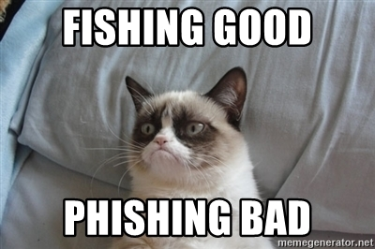
An enterprise security risk management plan based on APT29 threat intelligence
Training
Phishing training

Slide 55
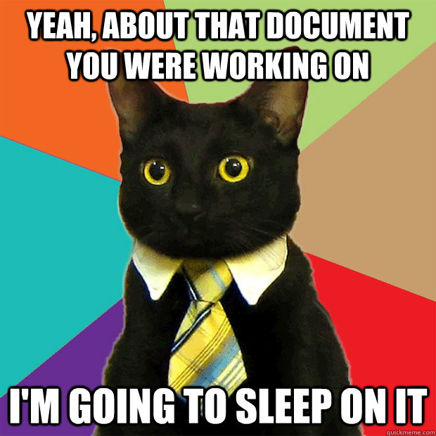
An enterprise security risk management plan based on APT29 threat intelligence
Policy
Hardening policy
Password policy
Privileged account management policy, DCs a priority
User Account Management policy, Remote Services a priority
Log management
Notes:
Hardening
Password
Privileged account management – DCs
User account management – remote services
Log management

Slide 56
An enterprise security risk management plan based on APT29 threat intelligence
Technology
Antivirus
Network Intrusion Prevention
Execution Prevention
2FA – Remote Services a priority
SIEM solution with rules for
Additions or modifications of mechanisms used to trigger event-based execution
Processes interacting with lsass.exe
Processes and command-line arguments for actions that gather system and network information
Interaction with the Windows API to gather information
Interaction with Windows system management tools - Windows Management Instrumentation and PowerShell
Writing of files with extensions and/or headers associated with compressed or encrypted file types, correlated with suspicious traffic out of the environment
Notes:
AV
NIP
Execution prevention
2fa – remote services
SIEM rules
Changes to mechanisms that trigger event based exe
Interacting with lsass exe
Processes and command line args gathering info
Windows system management tools – Windows Management Instrumentation and PowerShell
Files compressed/encrypted file types
Sus traffic out

Slide 57


Pick the threats that are applicable to you
Research what groups target your vertical and go from there
You don’t know what you will find until you look

Slide 58
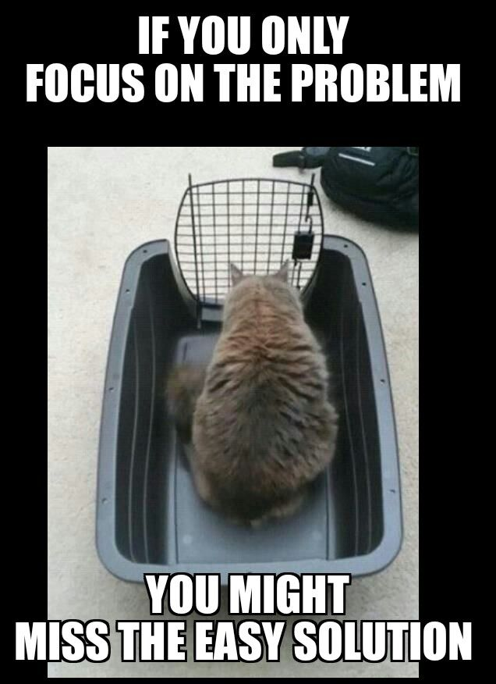
In Summary
Hard to disrupt adversaries with threat intelligence
Easier to make yourself a hard target
Rather than tactical threat intelligence, atomic IoCs, think about Strategic Threat Intelligence, TTPs
There’s a mountain of open source threat intelligence you can map to Mire Att&ck
Identify the most relevant TTPs to you
Turn strategic threat intelligence into prioritised control list
Notes:
Hard to distrupt with T I
Hard target
Atomic iocs – TTPs
Open source threat intelligence map mitre
Relevant TTPs
Prioritised control list

Slide 59
References
How very APT https://www.youtube.com/watch?v=wP2J9aYM6Oo
https://www.carbonblack.com/blog/the-dukes-of-moscow/
https://blog-assets.f-secure.com/wp-content/uploads/2020/03/18122307/F-Secure_Dukes_Whitepaper.pdf
https://www.welivesecurity.com/2019/10/17/operation-ghost-dukes-never-left/
https://archive.f-secure.com/weblog/archives/00002764.html
https://www.wired.com/story/cozy-bear-dukes-russian-hackers-new-tricks/
https://securelist.com/miniduke-is-back-nemesis-gemina-and-the-botgen-studio/64107/
https://securelist.com/the-cozyduke-apt/69731/
https://www.bbc.com/news/technology-29817644
https://securelist.com/the-cozyduke-apt/69731/https://edition.cnn.com/2015/03/10/politics/state-department-hack-worst-ever/
Notes:
References so you can validate everything we discussed

Slide 60
References
https://www.securityweek.com/cozyduke-apt-responsible-white-house-state-department-attacks-kaspersky
https://www.crowdstrike.com/blog/bears-midst-intrusion-democratic-national-committee/
https://www.volexity.com/blog/2016/11/09/powerduke-post-election-spear-phishing-campaigns-targeting-think-tanks-and-ngos/
https://www.fireeye.com/blog/threat-research/2018/11/not-so-cozy-an-uncomfortable-examination-of-a-suspected-apt29-phishing-campaign.html
https://unit42.paloaltonetworks.com/unit-42-technical-analysis-seaduke/
https://blog.crysys.hu/2013/02/miniduke/
https://us-cert.cisa.gov/sites/default/files/publications/AR-17-20045_Enhanced_Analysis_of_GRIZZLY_STEPPE_Activity.pdf
https://us-cert.cisa.gov/sites/default/files/publications/JAR_16-20296A_GRIZZLY%20STEPPE-2016-1229.pdf
https://unit42.paloaltonetworks.com/tracking-minidionis-cozycars-new-ride-is-related-to-seaduke/
Putting MITRE ATT&CK™ into Action with What You Have, Where You Are https://www.youtube.com/watch?v=bkfwMADar0M

Slide 61
If you want these slides, and the mapped reports
https://github.com/Panopticon-Project/panopticon-CozyBear/tree/master/MitreAtt%26ckTTPs

